Slide 1
Q1 2014 CAR Analysis
Team:
Alan Purvey
Julie Heinzinger
Mark Jessen
CAR Number: 133912654
CAR Number: 133911539
CAR Number: 133912730
CAR Number: 133912451

Slide 2
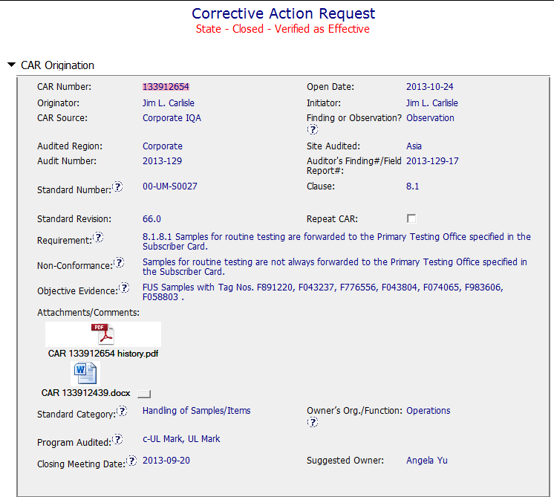
Observation:
Background
Could provide more specific detail of the evidence.
Sample Size to justify Observation?
Detailed analysis attached.

Slide 3
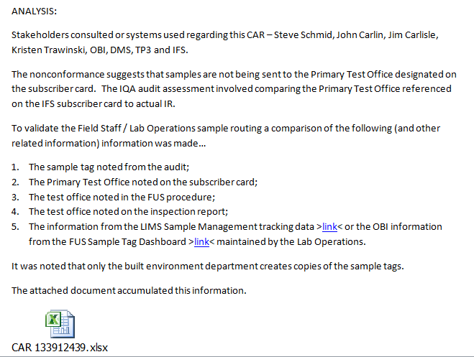
Owner
response
Page 1 of analysis showing stakeholders. Several pages of details and attachments follow.

Slide 4
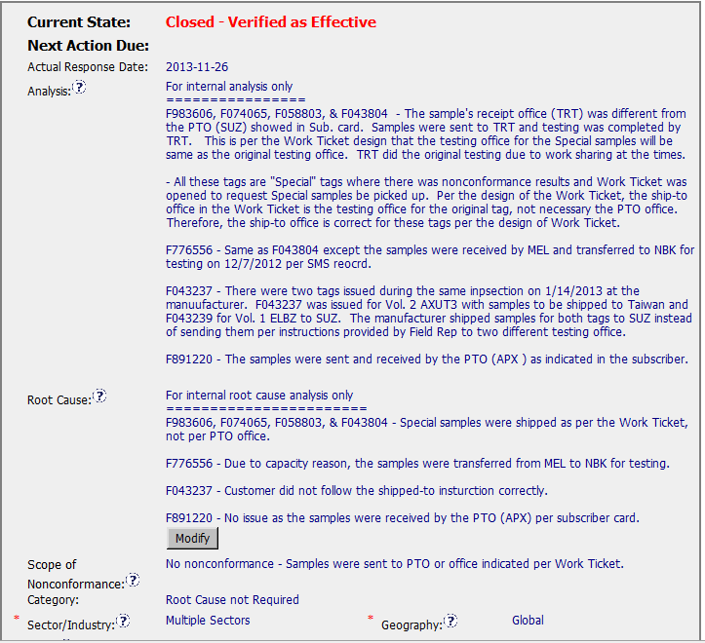
Analysis and Root Cause not required for an Observation.
Confused by “No nonconformance” since there is a Corrective Action.

Slide 5
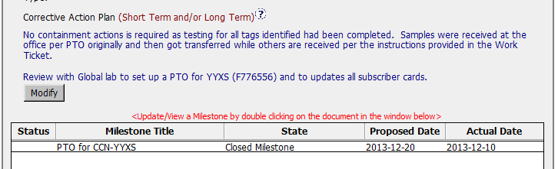
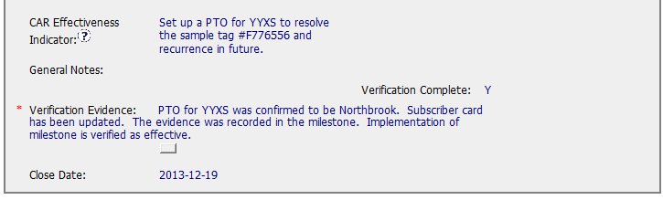
Observation 133912654
Analysis indicated that most issues were actually in compliance. Only one action to correct a PTO for YYXS was required to fix the issue.
Action is verified and Observation is closed.
Question?
Was this CAR originally a Finding, then changed to an Observation based on the Analysis?

Slide 6
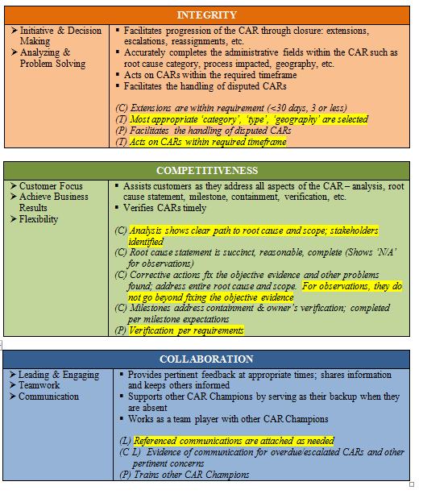
Observation 133912654

Slide 7
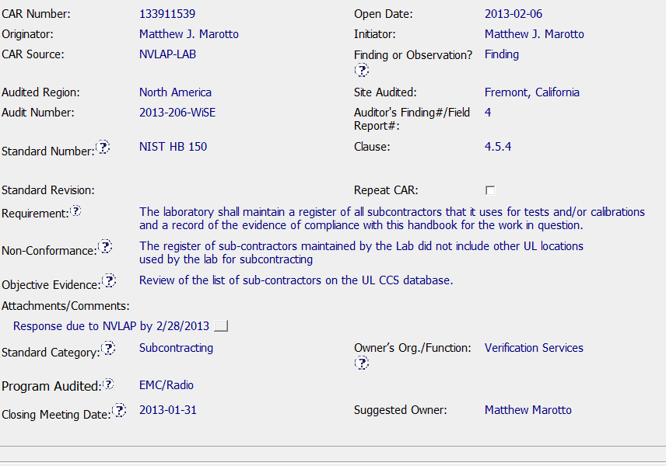
Exemplary CAR 133911539
Requirement matches Non-conformance and Objective
Evidence
Standard category and Program correct
NVLAP response date included

Slide 8
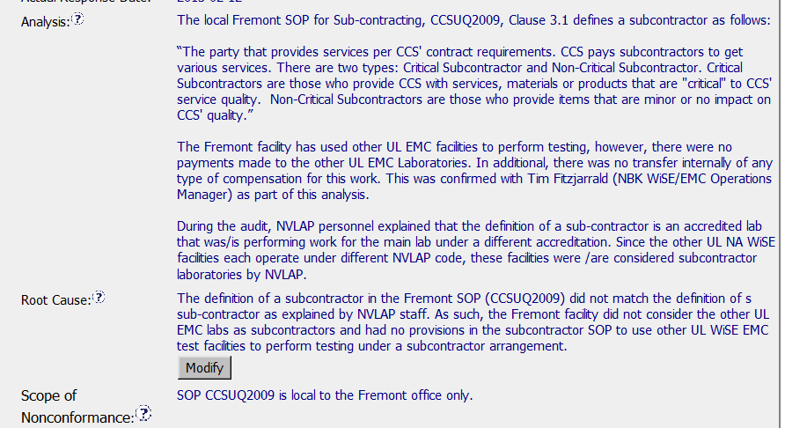
Exemplary CAR 133911539
Analysis identifies stakeholders and determines
Final root cause
Root Cause matches Analysis
Correct Scope of Non-conformance

Slide 9
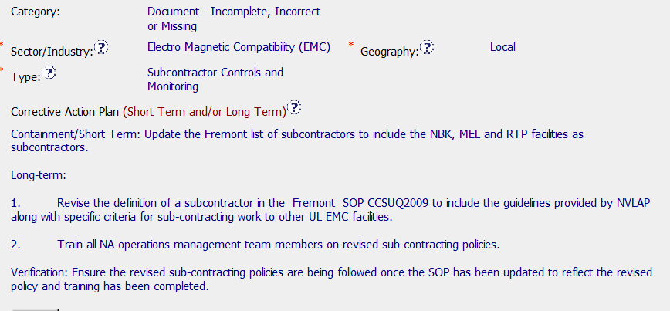
Exemplary CAR 133911539
Category, Sector, Type, Geography
correct
Corrective Action Plan matches Analysis
Containment and Verification addressed

Slide 10
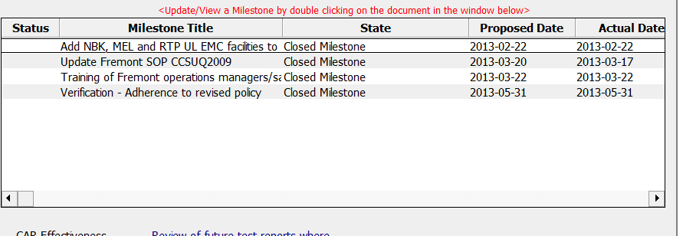
Exemplary CAR 133911539
Milestones match analysis and Corrective Action Plan
Containment and Verification addressed
Appropriate objective evidence attached (SOP, records of training and
Verification record)
Question – Corrective Action Plan states Train all NA operations
management team members – Milestone states Training of Fremont
operations managers/sales managers

Slide 11
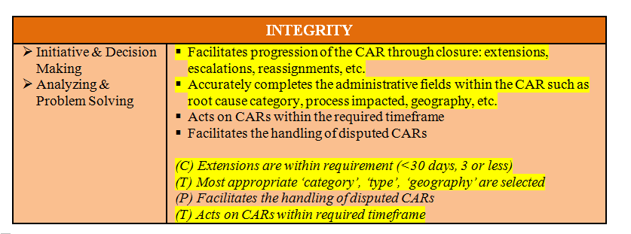
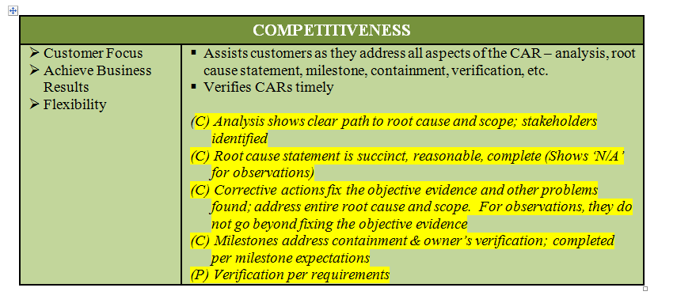
Exemplary CAR 133911539
CBS Met for the following

Slide 12
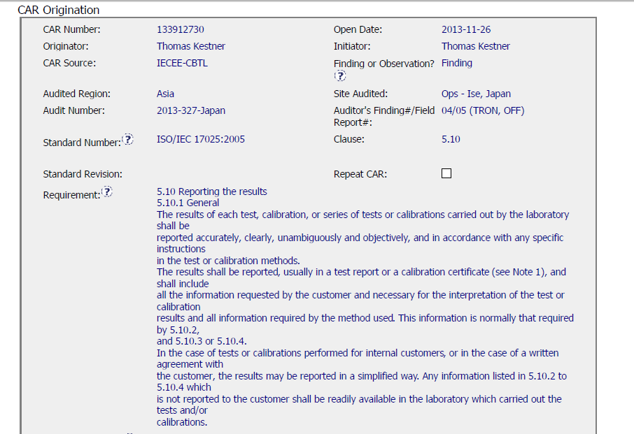
Finding CAR 133912730
Entered into GCAR timely - 4 days after the closing meeting.

Slide 13
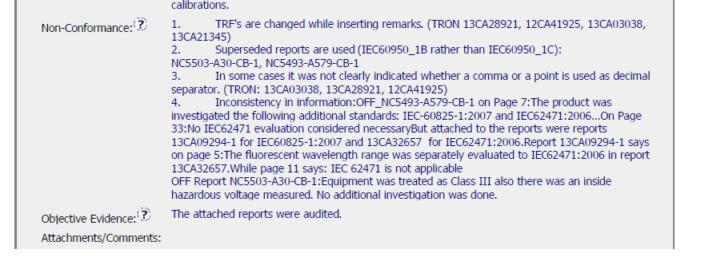
Finding CAR 133912730
not on attached table but referenced
13CA09294
13CA32657
Not clear how many were evaluated?
Usually the Non-conformance is x of x
This was an accreditor CAR and they are not always written as we would write them

Slide 14
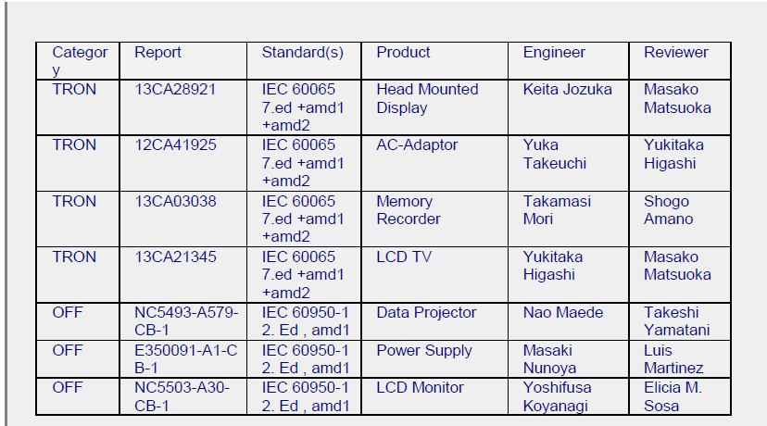
Finding CAR 133912730
Table attached in the comment / attachments section
Projects referenced in non-conformance but not on table
13CA09294
13CA32657

Slide 15
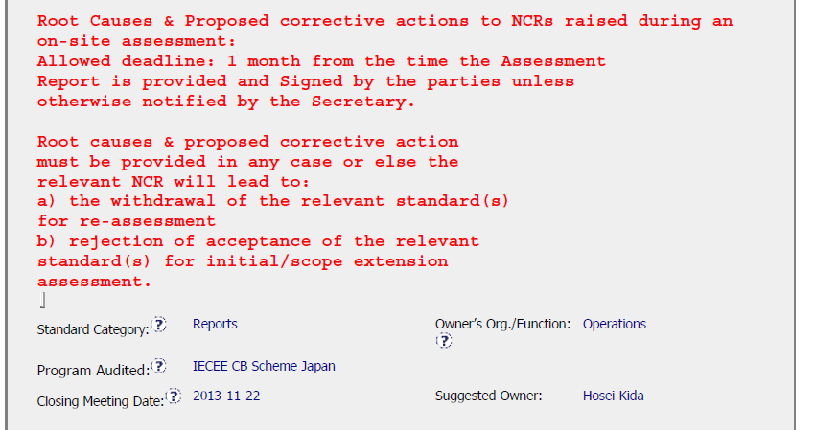
Finding CAR 133912730
Unclear when the root cause and proposed corrective action are due because we do not know when the assessment report is issued. Might be at the closing meeting, might be later.

Slide 16
Finding CAR 133912730 – Analysis Summary
It was confusing and hard to follow
Process used to evaluate was not explained in the analysis
It might have been best to break this up into manageable parts, especially if different people are responsible.
Explanation is missing
Without having some CB background anyone reading this will be extra confused since none of this is explained in the analysis.
Based on the ppt included in Milestone 1, it looks like more might have been done than what is in the analysis, however unless it is clearly documented in the analysis, how would anyone know?

Slide 17
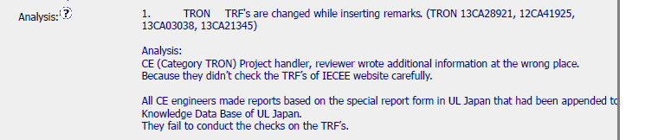
Finding CAR 133912730 - Analysis
Analysis incomplete
Who was consulted / involved in this analysis
Were the jobs in question examined during the analysis, and if so what did they indicate?
Is the issue the report form used or the changes being made?
NOT CLEAR IF THE ISSUE IS:
USE OF AN UNCONTROLLED FORM,
A FORM IS BEING CHANGED,
A COMBINATION OF THE TWO.
Who was consulted is not included, might be the project handler and reviewer, or it could be that the person conducting the analysis just guessed because of the nature of non-conformance.
Unclear if the projects in question were looked at during the analysis.
Unclear if the cause is that UL Japan has saved the TRF’s locally when the requirement is to take the forms from the IECEE website. Or if it has something to do with adding information to the form.
Not sure what “wrote additional information at the wrong place” means.

Slide 18
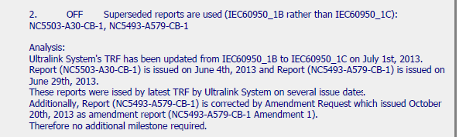

Finding CAR 133912730 - Analysis
Analysis incomplete
Who was consulted / involved in this analysis
Did not reference the UltraLink CAR 133912085 in the analysis, but it is included in the CAR Reference section
Did not address the Ultralink issue at all, just said it was fixed
Looks like one of the projects referenced was corrected [NC5493…]
The other project was not mentioned
Questions left unanswered:
Why were the old ones in Ultralink?
Why was it not updated at the time it reeved to C?
Could reference CAR here
How long has this been happening? When did rev C change?
Did someone give authorization to use the old ones?
Is whatever happed to Ultralink fixed so this will not happen again?
Not sure why no additional milestone is needed, and do they mean action rather than milestone? Either was incorrect.

Slide 19
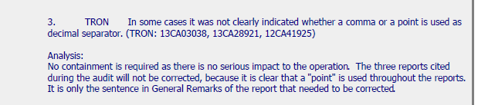
Finding CAR 133912730 - Analysis
Analysis incomplete
Who was consulted / involved in this analysis
Need more information, as to who looked at the projects to decide they were okay
Was it someone of authority (like L4) to determine there was no serious impact
Is there anything else that needs to be considered (like why did IECEE have an issue with this)
Indicated a sentence needs correction, but then nothing is changed.

Slide 20
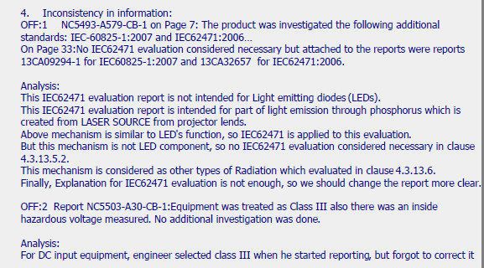
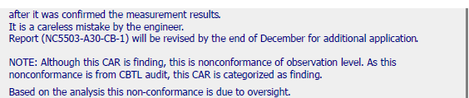
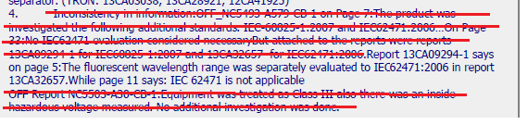
Finding CAR 133912730 - Analysis
Analysis incomplete
Who was consulted / involved in this analysis
No explanation and not how it is applicable to the analysis.
OFF 1 –
Without an explanation, not sure why LED’s matter, why radiation matters, etc.
Include title of IEC62471
Needs an explanation, especially when dealing with technical issues. Need to summarize so others can understand.
OFF 2 –
Without an explanation, not clear the difference between class III and ?
(guess, class II)
What needed to be changed?
NC indicated an investigation was need “ . . No additional investigation was done.” Should one be done or did the “careless mistake” cause the issue?
Why would this be an OBS? Is this necessary to include?
How can this statement pertain to the entire CAR?
Missed sentence from non-conformance. Thus, this issue was not addressed.

Slide 21

Finding CAR 133912730 – Root Cause and Scope
Root Cause:
Not appropriate,
All issues need to be addressed
Analysis was not done well, so it is unclear what the root causes are
Scope:
There was nothing in the analysis which indicated the scope of the issue. How do they know it is limited as indicated.

Slide 22
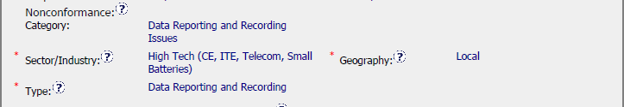
Finding CAR 133912730 – Scope
Without a complete analysis, it is not possible to determine the geography or the nonconformance category.

Slide 23
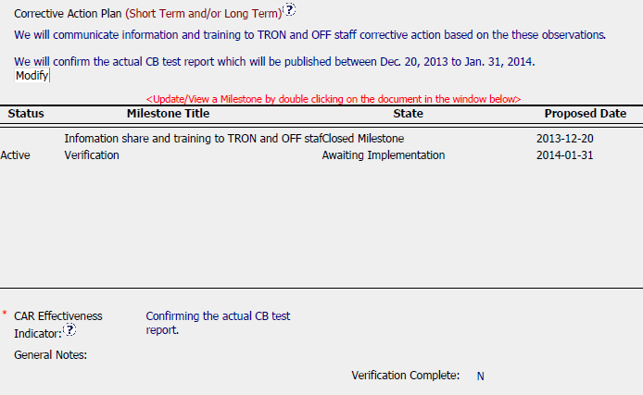
Finding CAR 133912730 – Corrective Action
Without a clear analysis, it is not possible to put together a relevant CAP.
If this were relevant, there is nothing indicating why these things would be done.
No containment or statement indicating why it is not needed (sort of tried to do this in parts of the analysis)
Not clear what the confirmation is about?

Slide 24
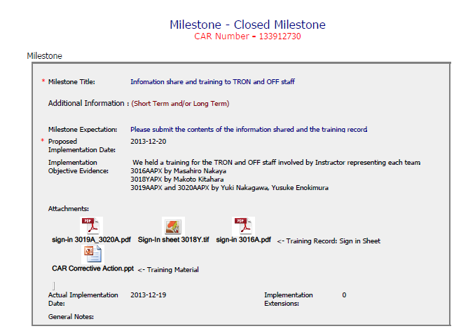
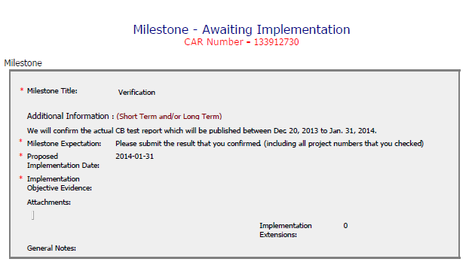
Finding CAR 133912730 – Milestones
At this point, not realistic to discuss milestones because they are based off a flawed analysis.

Slide 25
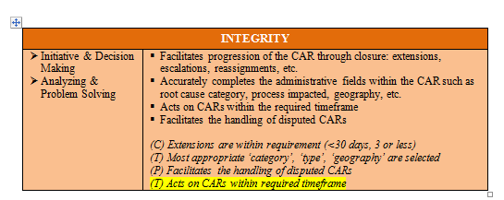
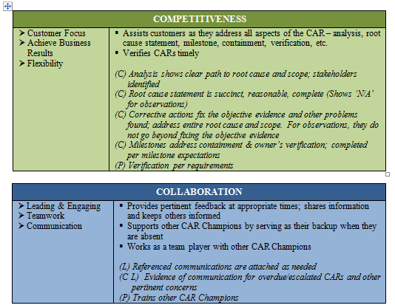
Finding CAR 133912730
Only 1 of the CBS criteria was demonstrated.

Slide 26
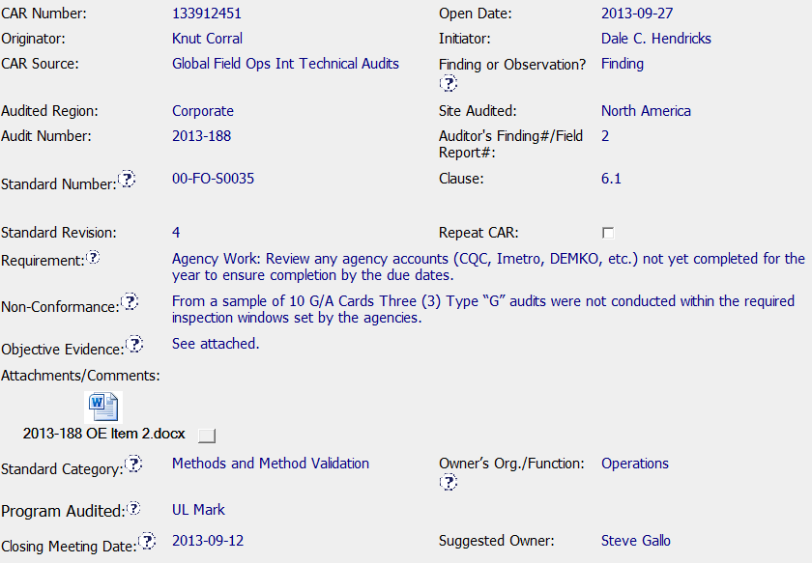
Finding CAR 133912451 – Front End
Good - Requirement matches Non-conformance
Sample size stated
Evidence attached

Slide 27
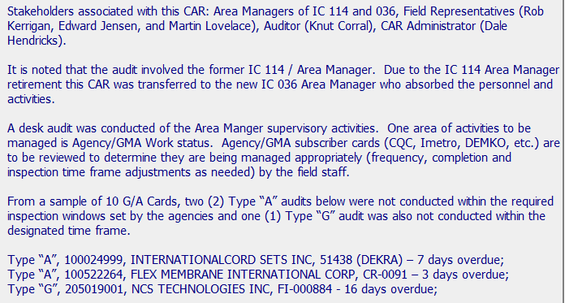
Finding CAR 133912451 – Analysis
Good - Stakeholders Identified
Remainder of Analysis summarizes audit finding and new responsibility – Note that finding cited three “G” and analysis cited 2 “A” and 1 “G”

Slide 28
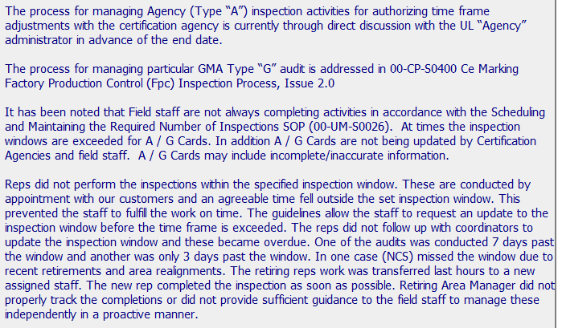
Finding CAR 133912451 – Analysis
Good - Process for A and G noted
Question – Cards not being updated by Certification Agencies, Field Staff and A/G Cards may include incomplete / inaccurate information not addressed further in CAR?
Investigation of root cause begins – 5 Whys to follow
On next slide

Slide 29
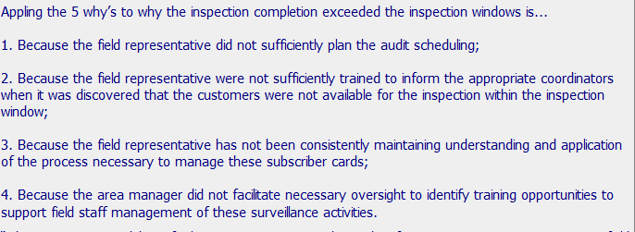
Finding CAR 133912451 – Analysis and Root Cause
Question – 5 Whys - Could additional “whys” have been asked? Why did Field Reps. not sufficiently plan the audits? Not clear why training is required for reaction to not meeting SOP requirements? Could additional causes beyond Area Manager oversight exist here? Additional documented details could have been helpful
Root Cause Statement – Well written and concise. Not clear if this is final root cause given questions above

Slide 30
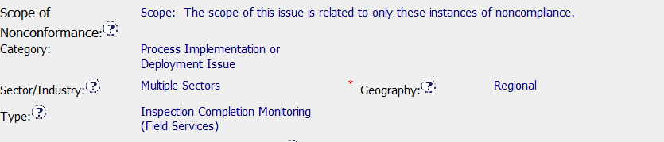
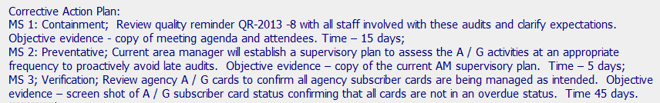
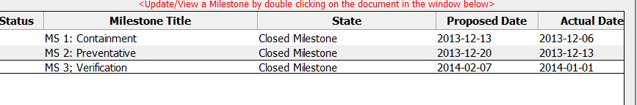
Finding CAR 133912451 – Analysis and Root Cause
Question – Could not identify how scope was determined - No evidence of consideration beyond objective evidence
Corrective Action Plan matches Analysis and Root Cause
Milestones match corrective action plan and contained
Appropriate evidence

Slide 31
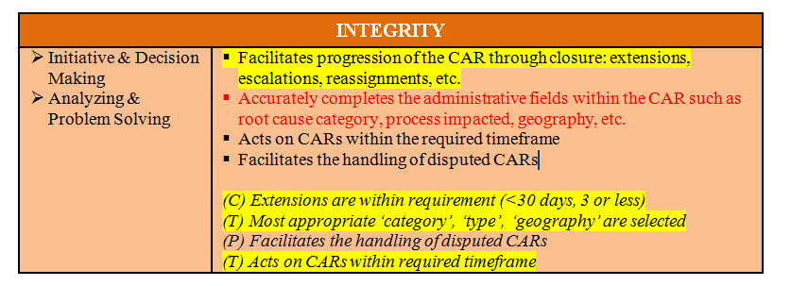
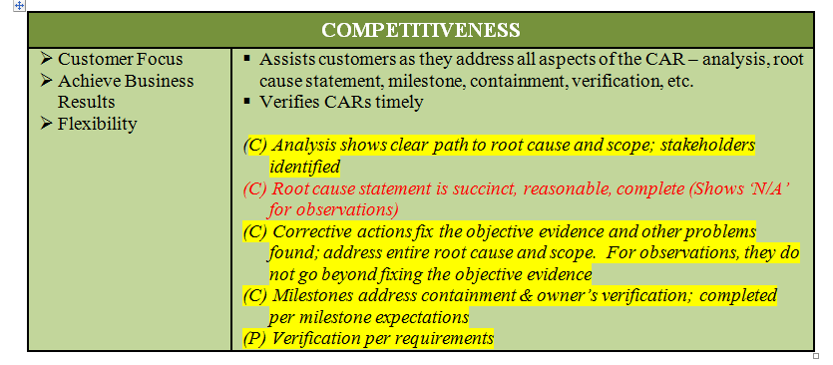
CAR Summary and CBS
CAR SUMMARY- Documenting in the CAR why training and supervisor oversight was determined to be the final root cause would be helpful
Yellow highlighting indicates CBS met
Question – Administrative CBS may not be met due to need to ask additional “whys”
Question – Root Cause CBS may not be met due to need to ask additional “whys”

Slide 32
Corrective Action Review for Calibration Meeting (March, 2014)
V 1.0

Slide 33
CAR 133912730
SUMMARY:
Good:
The champion assigned the correct Type, Category and Geography in the CAR database. The champion replied the CAR owner promptly. The owner acted on the CAR within the time frame. There was no extension required by the CAR owner.

Slide 34
CAR 133912730
SUMMARY:
Improvement Opportunities Identified:
Analysis: It is better to identify who was involved during the analysis.
Root Cause Statement: Root cause statement should match the analysis, especially for item 1.
Scope of Nonconformance: The CAR was deemed as Observation by the CAR owner. It is better that the CAR owner provides the evidence to support scope of nonconformance was limited to the projects cited, then the champion provides the comments and confirmation about this classification change and scope reduction.
Corrective Action plan: It is better that there are long term corrective actions to address all issues identified in the CAR from the root cause.
Milestone: According to 00-QA-S0006, V19.0, Containment milestone is required for the Corrective action to address Finding.

Slide 35
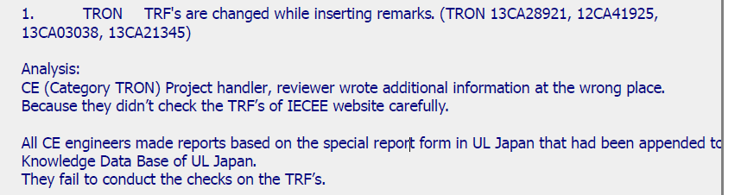
CAR 133912730
Analysis: It is better to identify who was involved during the analysis.

Slide 36
CAR 133912730
Root Cause Statement: Root cause statement should match the analysis, especially for item 1. Since all CE engineers did not use the TRF from IECEE CB website or Ultralink, it seems the issue was systematic instead of “ oversight”.

Slide 37
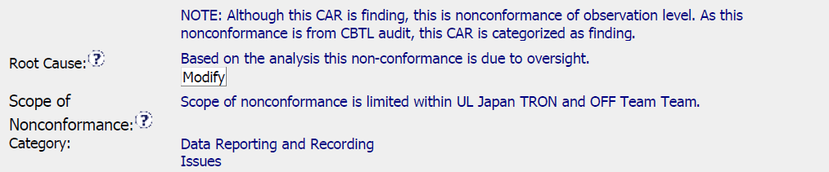
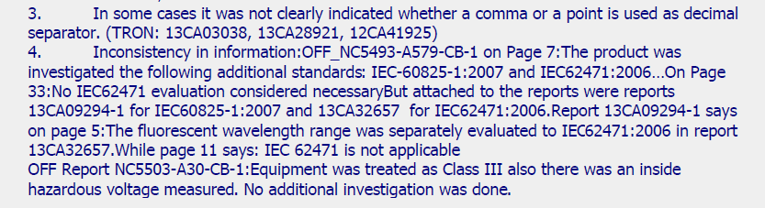
CAR 133912730
Scope of Nonconformance: The CAR was deemed as Observation by the CAR owner. It is better that the CAR owner provides the evidence to support scope of nonconformance was limited to the projects cited, then the champion provides the comments and confirmation about this classification change and scope reduction.
There was no evidence that item 3 and item 4 of nonconformance evidence were limited to the projects identified.

Slide 38
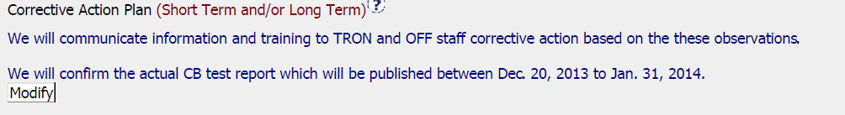
CAR 133912730
Corrective Action plan: It is better that there are long term corrective actions to address all issues identified in the CAR from the root cause.

Slide 39
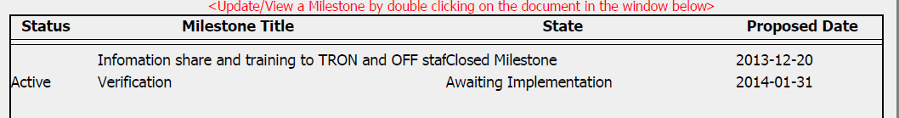
CAR 133912730
Milestone: According to 00-QA-S0006, V19.0, Containment milestone is required for the Corrective action to address Finding.

Slide 40
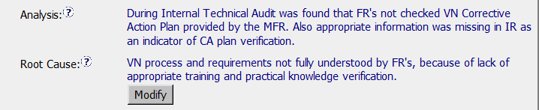
CAR 133912279
There should be a stronger analysis path, possibly the 5 whys, including stakeholders identified.
No evidence to support the nonconformance limited to instances cited.
Based on the analysis, difficult to see how the root cause was discovered.

Slide 41
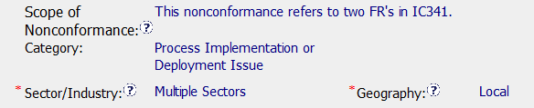
CAR 133912279
As a Finding, there is no evidence that there was additional research done to insure that this non-compliance is limited to these two FR’s
If the root cause is a training issue is the category Process Implementation or Deployment the correct category?
If this non-compliance spans over multiple sectors, and without additional research on how wide spread this concern maybe is Geography: Local appropriate?

Slide 42
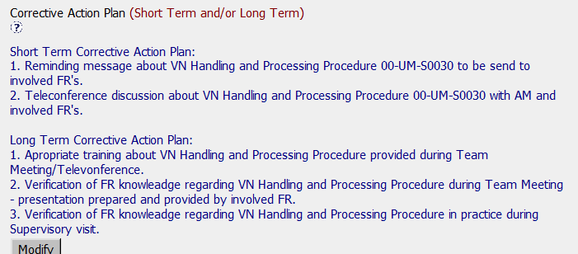
CAR 133912279
Based on the corrective action given the plan for retraining is good
Was this training missed? When are the team members supposed to be trained on this?

Slide 43
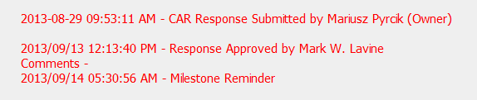
CAR 133912279
Delay in response time for CAR champion from response submitted 8/29 to approval 9/13 – over 9 day preferred time frame

Slide 44
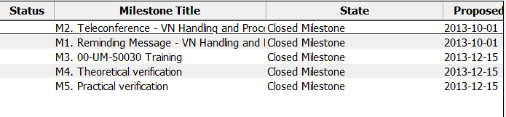
CAR 133912279
Good Implementation on all milestones
Good collaboration between CAR champion and CAR owner

Slide 45
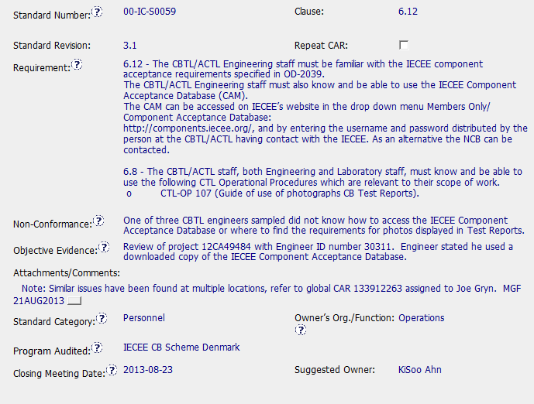
Observation CAR 133912331

Slide 46
Observation CAR 133912331
Simple, brief action appropriate to magnitude of issue.
Reference to global CAR for more systemic issue.
Immediate response by admin; immediate verification after closure.
No wasted time and/or effort, considering scope of observation

Slide 47
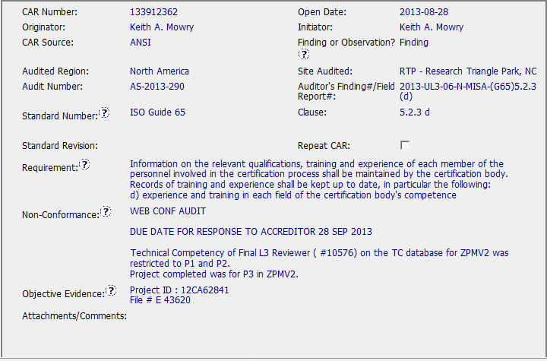
CAR 133912362
Issue: Lack of Competency qualification

Slide 48
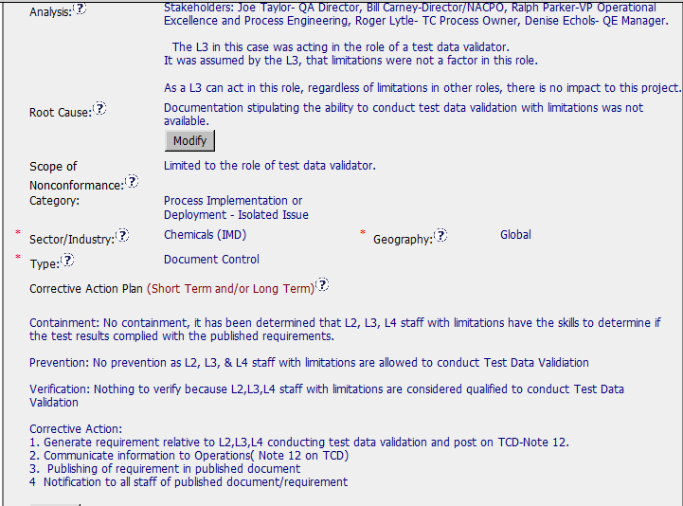
CAR 133912362

Slide 49
CAR 133912362- Questions:
Who determined that personnel had qualification to do Test Data Validation?
Why is root cause “document control”? Maybe “Tech Comp Qualification” instead?
Why not verified immediately after closing due to nature of corrective action?
Lack of verification milestone should be addressed, as was containment.
Overall appropriate and timely action taken. Moved along nicely by admin.

Slide 50
CAR Calibration Meeting CAR Review
AP Team
Funny Li, Ravi V, Matthew Kim, J.Y. Lee and Kila Yang
February 2014

Slide 51

CAR Champion Critical Behaviors for Success
Alignment with Critical Behaviors for Success and UL Values
CAR Champion, Areas of Responsibility:
C – Customer; T – Technical; L – Colleague; P – Process.
Notes:
EIGHT (8) CBS attributes :-
(CAR Champion, Areas of Responsibility: C – Customer; T – Technical; L – Colleague; P – Process)

Slide 52
Study for CAR# 133912279 by J.Y. Lee

Slide 53

CAR# 133912279
3
2
1
4
1
2
3
4

Slide 54

CAR# 133912279 (Analysis)
No stakeholders involved in this Analysis, no detail analysis conducted for the cited above 4 non-conformance
1. Re-statement of non-conformance
2. Based on FAQ19 of CAR Process Website, the true root cause has not yet been found. (http://corporate.ul.com/departments/snk5212/QE/FAQ.cfm)
9 VNs involved, no analysis conducted to determine its spread.
No containment actions taken for this Finding CAR
No actions taken for these impacted VNs.

Slide 55


CAR# 133912279 (Milestone 1)
[PDF file content] Wrong CAR No. description

Slide 56

CAR# 133912279 (Milestone 2)

Slide 57

CAR# 133912279 (Milestone 3)

Slide 58

CAR# 133912279 (Milestone 4)

Slide 59

CAR# 133912279 (Milestone 5)

Slide 60

CAR# 133912279 (Document History)

Slide 61

CAR# 133912279 (Document History)

Slide 62

CAR# 133912279 (CAR Champion CBS)

Slide 63
Study for CAR# 133912451 by V Ravichander

Slide 64

CAR# 133912451
Integrity
Short and clear description of Non-conformance & Objective evidence
All relevant fields filled

Slide 65


CAR# 133912451
Competitiveness
5 Whys approach for analysis and leads to defining the root cause statement
Stakeholders consultation

Slide 66

CAR# 133912451
Competitiveness
Precise root cause statement
Clear definition of scope of non conformance
Integrity
All administrative fields filled effectively

Slide 67

CAR# 133912451
Competitiveness
Three step corrective action plan with 3 distinct milestones
Integrity
All administrative fields filled effectively

Slide 68

CAR# 133912451
Integrity
Containment milestone with evidence – clear and neat
Competitiveness
Timely review and verification of milestone

Slide 69

CAR# 133912451
Integrity
Preventative milestone with evidence – clear and neat
Proposed implementation date changed to facilitate implementation, but meets the requirements <30days
Reason is ??
Competitiveness
Timely review and verification of milestone

Slide 70

CAR# 133912451
Integrity
Verification milestone with evidence – clear and neat
Proposed implementation date changed to facilitate the implementation
Reason ???
Competitiveness
Timely review and verification of milestone

Slide 71

CAR# 133912451
Collaboration
Nice way to close the CAR

Slide 72
Study for CAR# 133912770 by Kila Yang

Slide 73

CAR# 133912770
The non-conformance is to use the equipment without calibration.
Notes:
For the CAR# 13392770:
[CAR Review based on 00-QA-S0006 - Corrective Action Request Process]
This CAR is related the lab testing staff used the non-calibration equipment to conduct the test.

Slide 74

CAR# 133912770 (Corrective Action Plan)
This is an Observation CAR, It’s not required for these three fields.
[Integrity] (T) Most appropriate ‘category’, ‘type’, ‘geography’ are selected
[Competitiveness] (C) – Ensuring the ‘Category’ is “Root Cause not Required” for this observation CAR. (C) – Corrective actions fix the objective evidence, do not go beyond fixing the objective evidence for this observation CAR.
Notes:
For the CAR# 13392770:
This is an Observation CAR, It’s not required for Analysis and Root Cause description.

Slide 75

CAR# 133912770 (Milestone)
Equipment Calibration Certificate and LEM screen shot are attached.
Email reminder and prevent the similar issue occurred.

Slide 76


CAR# 133912770 (Milestone)
[Competitiveness] (P) Providing the sufficient information for verification.
[Integrity] (C) Extensions are within requirement (<30 days, 3 or less) (T) Acts on CARs within required timeframe

Slide 77
Study for “exemplary” CAR# 133912082 by Funny Li

Slide 78
CAR# 133912082
This CAR was initiated by CNAS in Chinese. CNAS auditor didn’t accept first hand testing data was recorded in laptop directly, so it’s concluded the data was not recorded at the time of testing.
This CAR was handled by Erica Qin as trainee, supported and reviewed by Kyle Huang.
.
 | CAR Number: | 133912082 |  | Open Date: | 2013-06-26
 | Originator: | Erica Qin |  | Initiator: | Erica Qin
 | CAR Source: | CNAS |  | Finding or Observation? | Finding
 | Audited Region: | Asia |  | Site Audited: | GUZ- Guangzhou, China
 | Audit Number: | 2013-276 |  | Auditor's Finding#/Field Report#: | 2013-276-01
 | Standard Number: | ISO/17025 |  | Clause: | 4.13.2
 | Standard Revision: | 2005 |  | Repeat CAR:
 | Requirement: | 4.13.2.2 Observations, data and calculations shall be recorded at the time they are made and shall be identifiable to the specific task. UL Procedure: 00-LC-S0258 Datasheet Package Preparation, Review and Handling, and Data Recording Procedure.
 | Non-Conformance: | The data and the description of testing results for lithium ion battery vibration test,crushing of cells and low-pressure test, etc. in the Records of Testing were printed. They were not recorded by the testing staff at the time of testing
 | Objective Evidence: | Testing Report No:12CB1001-A-1 : The Records of lithium ion battery vibration test,crushing of cells and low-pressure test, etc. were reviewed. The data and the description of testing results were printed. They were not recorded by the testing staff at the time of testing.
 | Attachments/Comments:
 | From: Wu, Jamway Sent: Tuesday, July 02, 2013 9:08 PMTo: Huang, KaiCc: Qin, Erica; Li, Funny; Liu, Lily; Chen, NelsonSubject: RE: Seeking your clarification on CAR 133912082 Hi Kyle, The reality for this case is, at the end of the test, technician went to the observe the final test result after test completed, and did some works for taking away the tested sample from the fixture and cleaning the fixture, then he moved to the laptop which was 10 meters away from the testing area to record the result in his laptop. Frankly there was a few minutes passed from observing the final result to recording it. The argument between CNAS auditor and our representative is, they require the “第一时间” but we claimed that we did not do any other test before recording the test result. However, we could not show the concrete evidence that the record is in “第一时间” because everything in our record is electronic even we print it out.
 | Standard Category: | Records |  | Owner’s Org./Function: | Global Labs
In order to clarify the actual situation with CAR trainer and supporter, the related communication information was attached.
It told clear background.
Standard Category was identified correctly.
[Collaboration] (P) – Fully communication between trainee and trainer
[Integrity] (T) – Clear message provided and clarified.

Slide 79
CAR# 133912082 (Analysis)
The “5 WHYs” approach had been utilized well. Besides, the last Y helped to identify the scope of non-conformances.
The “5 WHYs” concluded two different testing with two different root causes. Which were clearly listed one by one.
The causes didn’t go further like “lack of understanding to requirements” since there were gray area existed by CNAS auditor for electronic records.
Current State: | Closed - Verified as Effective
Next Action Due:
Actual Response Date: | 2013-07-17
Analysis: | 2013-07-01 10:00 Stakeholder: Erica Qin(Quality Assurance Analyst),Nelson Chen(CAS Engineer Leader),Jamway Wu (Lab Manager)Lily Liu (Lab Team Leader), Devin He, Alex Lin, Jason Chen (Lab Technician), 3027CGUB team. Q: Why did not record the crush testing result at the time of testing shown in non-conformance description? A: Due to crush testing with safety risk, it is not appropriate for testing staff to record the results at the scene of testing. Therefore, the video camera has been installed at crush testing area since battery lab establishment; make sure the original results can be observed directly through the display screen placed in office working area. So actually we have recorded the crush testing results in electronic datasheet at the time of testing in office working area. Q: Why was crush testing still include in the non-conformance description？ A：We have explained the specific data recording way of crush testing results to the auditor, the auditor said that it depends on us and suggested to identify the testing items by ourselves. So based on the actual practice and analysis as per auditor comments, crush testing data recording was excluded from non-conformance scope. Q: Why did not record the vibration testing and low pressure testing results at the time of testing? A: For vibration and low pressure testing, we observed testing results during the testing. But for safety concern, we shall take away the tested sample from the fixture ,which takes 2 minutes normally. Then we moved to laptop placed in the office working area, which was around 10 meters away from testing area to record the results in electronic datasheet. Q: Why cannot record the results at the vibration testing and low pressure testing area? A: There is no table near vibration testing and low pressure testing area to place our laptop; therefore we could not record the results at the testing area at the time of testing, but need to go to office working area to key in electronic datasheet saved in our laptop. Q: Is this an individual case in GUB lab? A: Yes, only battery testing area exist high safety risk in GUB lab. Q: Is there any other battery testing items having the same data recording issue? A: No other testing items except vibration testing and low pressure testing area. For other battery testing items with safety concern, thermocouples have been used for monitor the temperature of each sample, so testing staff can record results at the time of testing.
Root Cause: | 1. For vibration testing and low pressure testing, no table near testing area to place our laptop to recorded testing results in electronic datasheet at the time of testing. 2. For crush testing, we observed the original results through camera display screen in office working area, and recorded the crush testing results in electronic datasheet at the time of testing.
Scope of Nonconformance: | IEC62133 vibration testing and low pressure testing
Category: | Data Reporting and Recording Issues
Sector/Industry: | High Tech (CE, ITE, Telecom, Small Batteries) | * | Geography: | Local
Type: | Data Reporting and Recording
[Collaboration] (C L) – Fully communication with CAR owner
[Competitiveness] (C) – Clear path from analysis to root causes
[Integrity] (P) – Root causes hit the points and very practical.
Notes:
Analysis – clear path to root cause; stakeholders identified
There are TWO (2) discrepancies: a) Failure conducting Management Review in the required time period, and b) Missing input element in the Management Review process. There should be two separate root cause analysis.
The “5 WHYs” approach hasn’t been utilized well because it doesn’t seem that it is able to identify the possible causes. For example, as mentioned in the “Analysis” field that “There was no general framework to set up an utilizable management review in that period. Thus the issue of the review has been postponed….” It is questionable whether it is specifically illustrated in the DEWI Quality Manual about the process and framework of Management Review, or the process is not even existing, or other reasons resulting now Management Review is not executed in the required timeframe after a personnel left the organization? The “5 WHYs” analysis can go further deeper.
In addition, does a statement “… Thus the issue of the review has been postponed.” mean that does the previous Management Review officially determine to be postponed? If yes, is there any supporting evidence?
And there is no analysis related to illustrate why “Recommendation for improvement” is not covered as input in the process of Management Review stated in the current DEWI Quality Manual.

Slide 80
CAR# 133912082 (Root Cause & Scope)
Current State: | Closed - Verified as Effective
Next Action Due:
Actual Response Date: | 2013-07-17
Analysis: | 2013-07-01 10:00 Stakeholder: Erica Qin(Quality Assurance Analyst),Nelson Chen(CAS Engineer Leader),Jamway Wu (Lab Manager)Lily Liu (Lab Team Leader), Devin He, Alex Lin, Jason Chen (Lab Technician), 3027CGUB team. Q: Why did not record the crush testing result at the time of testing shown in non-conformance description? A: Due to crush testing with safety risk, it is not appropriate for testing staff to record the results at the scene of testing. Therefore, the video camera has been installed at crush testing area since battery lab establishment; make sure the original results can be observed directly through the display screen placed in office working area. So actually we have recorded the crush testing results in electronic datasheet at the time of testing in office working area. Q: Why was crush testing still include in the non-conformance description？ A：We have explained the specific data recording way of crush testing results to the auditor, the auditor said that it depends on us and suggested to identify the testing items by ourselves. So based on the actual practice and analysis as per auditor comments, crush testing data recording was excluded from non-conformance scope. Q: Why did not record the vibration testing and low pressure testing results at the time of testing? A: For vibration and low pressure testing, we observed testing results during the testing. But for safety concern, we shall take away the tested sample from the fixture ,which takes 2 minutes normally. Then we moved to laptop placed in the office working area, which was around 10 meters away from testing area to record the results in electronic datasheet. Q: Why cannot record the results at the vibration testing and low pressure testing area? A: There is no table near vibration testing and low pressure testing area to place our laptop; therefore we could not record the results at the testing area at the time of testing, but need to go to office working area to key in electronic datasheet saved in our laptop. Q: Is this an individual case in GUB lab? A: Yes, only battery testing area exist high safety risk in GUB lab. Q: Is there any other battery testing items having the same data recording issue? A: No other testing items except vibration testing and low pressure testing area. For other battery testing items with safety concern, thermocouples have been used for monitor the temperature of each sample, so testing staff can record results at the time of testing.
Root Cause: | 1. For vibration testing and low pressure testing, no table near testing area to place our laptop to recorded testing results in electronic datasheet at the time of testing. 2. For crush testing, we observed the original results through camera display screen in office working area, and recorded the crush testing results in electronic datasheet at the time of testing.
Scope of Nonconformance: | IEC62133 vibration testing and low pressure testing
Category: | Data Reporting and Recording Issues
Sector/Industry: | High Tech (CE, ITE, Telecom, Small Batteries) | * | Geography: | Local
Type: | Data Reporting and Recording
Scope of Nonconformance Category was selected,
Sector/Industry was relevant.
Type and Geography was clear.
[Collaboration] (C L) – Scope is clearly identified.
Notes:
Root Cause – is succinct; reasonable and complete based upon the analysis
Not quite sure whether how would the process and initiator of the Management Review be outlined in the Quality Manual or the related SOPs. For the instance, is there a deputy person being determined to keep running of the Management Review process for any reason the initiator is absence.
Absence of the initiator in this case is not necessary resulting the failure of the quality process. [Refer to back to the result of the root cause analysis]
As mentioned above, there should be two separate root cause analysis. Another root cause is not addressed and identified.
Scope – tells how widespread the problem is
The widespread of the discrepancy has not been addressed in this field. e.g. How would it be affected by division, operation team, function, area/region, and the time period?
Remarks: Prior to the CAR review, if I were the CAR Administrator, it is necessary to clarify what are the differences to the organizations of DEWI and DEWI Wilhelmshaven, are they different entities? And is there any operation connection to DEWI-OCC?

Slide 81

CAR# 133912082 (Corrective Action)
Firstly containment actions were taken to stop testing before the right data recording method conducted.
Two Corrective actions were logically linked with root causes identified.
Verification was planned to ensure actions would be sustained.
Three milestones were setup to put actions into implementation, and all milestones were closed timely.
[Collaboration] (C L) – To be improved by working with CAR Owner to get the reasonable CA Plan that is able to fix the root cause.
[Competitiveness] (C) – To be improved by engaging with CAR Owner to fix the objective evidence and other problems found.
[Integrity] (P) – To be improved of determination by declining the insufficient CA Plan.
One comment, may consider to separate into two milestones for two corrective actions if they were actually completed in different schedule.
Notes:
Corrective Actions – fix the objective evidence
If it only addresses the Containment to the “Root Cause” recorded above, I think it is sufficient…
However, the reason of why failure conducting of previous Management Review is not addressed in the fields of “Root Cause” and “Correction Action Plan”.
Corrective Actions – address the entire root cause
As noted above, it is sufficient to cover the containment action though, the corrective action managing the root cause has not been addressed.
Again, there is no any corrective action related to address why “Recommendation for improvement” is not covered as input in the process of Management Review stated in the current DEWI Quality Manual.
Corrective Actions – address the items identified in the analysis
As noted above.
Corrective Actions – cover the scope and geography
Comment as stated in “Geography” above.

Slide 82

CAR# 133912082 (CAR Admin Review)
Good and No Abnormality
The 3rd level manager was changed to Joe from Ben Miller
This sometimes may be ignored when 4th level was well default there.
[Collaboration] (C L) – Good. CAR Owner, CAR Escalation Path and Optional Recipients are set appropriately.
Notes:
Good and no abnormality is found.

Slide 83

CAR# 133912082 (Milestone_1)
Milestone for containment is good with evidences provided.
[Collaboration] (L, C L) – Good. Containment and its supporting evidence are reviewed appropriately.
Notes:
Milestones – address containment unless CAP indicates reason why not required
Milestone solely for containment is good but not for corrective action. [Suggest to inviting a person could read German for verification whether “Recommendation for improvement” is now covered as input in the process of Management Review.]
See below comments for corrective actions.

Slide 84

CAR# 133912082 (Milestone_2)
Milestone for containment is good with evidences provided.
[Collaboration] (L, C L) – Expectation was setup with CAR owner.
[Competitiveness] (P) – CAR Owner complete d milestone as per expectation.
[Integrity] (P) – Milestone was completed, reviewed and completed in time.
Notes:
Milestones – have final milestone for owner’s verification of effectiveness; enough time is allowed for new records to be examined
Although CAR owner self-verification is added at the last milestone, it doesn’t cover the corrective action for the failure conducting previous Management Review.
In fact, would the next round of Management Review be able to conducted on-time, it has not been addressed.
It is suggested that the verification should focus on whether the updated process and/or next round of Management Review is in place to avoid recurrence of such nonconformity.
Milestones – completed per milestone expectations
It is acceptable as Containment Action for the supporting evidence covered in the 1st milestone, i.e. Management Review Report for Year 2011 and Year 2012 [Suggest to inviting a person could read German for verification…].
However, the evidence “Attachment of the management review 2013 in milestone one. The effectiveness of the management review was reviewed by the EULA Region Quality Manager and found to be acceptable.” stated in the 2nd milestone is irrelevant while the Management Review for Year 2013 has not been conducted yet. Not sure how CAR Administrator accepts it.
In addition, for 2nd milestone, it is suggested that a statement should be provided by CAR Owner to indicate that “Recommendation for improvement” is now covered as input in the process of Management Review for Year 2011 and 2012...

Slide 85

CAR# 133912082 (Milestone_3)
Milestone for containment is good with evidences provided.
[Collaboration] (L, C L) – Expectation was setup with CAR owner.
[Competitiveness] (P) – CAR Owner complete d milestone as per expectation.
[Integrity] (P) – Milestone was completed, reviewed and completed in time.
Notes:
Milestones – have final milestone for owner’s verification of effectiveness; enough time is allowed for new records to be examined
Although CAR owner self-verification is added at the last milestone, it doesn’t cover the corrective action for the failure conducting previous Management Review.
In fact, would the next round of Management Review be able to conducted on-time, it has not been addressed.
It is suggested that the verification should focus on whether the updated process and/or next round of Management Review is in place to avoid recurrence of such nonconformity.
Milestones – completed per milestone expectations
It is acceptable as Containment Action for the supporting evidence covered in the 1st milestone, i.e. Management Review Report for Year 2011 and Year 2012 [Suggest to inviting a person could read German for verification…].
However, the evidence “Attachment of the management review 2013 in milestone one. The effectiveness of the management review was reviewed by the EULA Region Quality Manager and found to be acceptable.” stated in the 2nd milestone is irrelevant while the Management Review for Year 2013 has not been conducted yet. Not sure how CAR Administrator accepts it.
In addition, for 2nd milestone, it is suggested that a statement should be provided by CAR Owner to indicate that “Recommendation for improvement” is now covered as input in the process of Management Review for Year 2011 and 2012...

Slide 86

CAR# 133912082 (Verification)
This CAR was verified with checking both actual project and technicians who conducted testing.
Verification was concluded effective.
One comment: This CAR was verified on Nov 8, which was quite close to the close date of last milestone (Oct 15).
[Collaboration] (C L) – Proactively working with CAR Owner to verify the effectiveness of the agreed CA Plan.
[Integrity] (P, T) –Reasonable verification evidences provided and sufficient verification to be considered.
Notes:
Verification – completed within 6 months of CAR closure or explanation provided; enough time is allowed for new records to be examined
Please be noted that this CAR hasn’t been closed yet. It is still under a state of “Closed Awaiting Verification”, hence, the field of “Verification Evidence” is still kept empty.
However, when both root cause identification and the related corrective action stated in 2nd milestone are questionable, the comment “The corrective action was effective” stated in the field of “CAR Effectiveness Indicator” shows too generic and lack of logical consideration…
If I were the CAR Administrator, will suggest the CAR Owner to reconsider the revisit of the current Management Review process and hence fill up the loophole resulting this nonconformance by adding one or two more milestones to illustrate and support the proper completion of corresponding efforts / activities. The timeline of last milestone for CAR Owner self-verification could be set right after completion of Management Review for Year 2013.
For the “General Notes”, shouldn’t it be an analysis field provided by CAR Owner instead of CAR Admin?

Slide 87
THANK YOU.

